Slide 1

X-ray Diffraction
CHEM-E5140
Materials Characterization
Girish Tewari
17.3.2025

Slide 2
Outline
Introduction to X-rays
Theoretical Principle (Bragg’s Law)
Basics of Crystallography
Diffractometers (Powder and Thin films)
Diffraction methods
Understanding powder diffraction
What can be studied with XRD
Horizontal Bragg-Brentano geometric arrangement of x-ray diffractometer

Slide 3
What are X-Rays?
• Discovered by Wilhelm Röntgen (1845-1923) in 1895 .
• X-rays are short-wavelength and high energy electromagnetic radiation.
• Wavelength 0.1 Å to 100 Å, (3×10¹⁶ Hz to 3×10¹⁹ Hz) (0.5 – 2.5Å used in diffraction).
• Production of X-rays: X-ray tube and synchrotron.
http://en.wikipedia.org/wiki/File:X-ray_applications.svg
Properties of X-Rays
Applications for X-Rays. Radiography; X-ray crystallography (XRD); X-ray
fluorescence spectrometry (XRF); X-ray photoelectron spectroscopy (XPS); X-ray microscopy.

Slide 4
Length Scale and Method of Observation

Slide 5
X-Ray Source: X-Ray Tube
X-rays are produced whenever high-speed electrons collide with a metal target.
A source of electrons – hot W filament, a high accelerating voltage between the cathode (W) and the anode (metal target), Cu, Al, Mo, Mg.
The anode is a water-cooled block of Cu containing desired target metal.
X-ray tube structure. X-ray radiation from the anode is guided by the windows of the tube to produce an X-ray beam for diffraction. Material Characterization course book 2008 edition

Slide 6
Produce of X-ray
Wavelength

Slide 7
Characteristic X-ray Lines
K_{b} and K_{a2} will cause extra peaks in XRD pattern, and shape changes, but can be eliminated by adding filters.
X-ray Absorption
----- is the mass absorption coefficient of Zr.
To obtain monochromatic K_{α}, a filter system is necessary to filter out the continuous X-rays and other characteristic X-rays, which are generated with Kα from the X-ray tube.
X-ray filters can be made from material that strongly absorbs X-rays other than K_{α}.
Intensity
Table Characteristic X-rays of Anode Materials
Anode | Atomic Number) | Kα (nm) | Critical Excitation Potential (keV) | Optimum Voltage (kV)
Cr | 24 | 0.22291 | 5.99 | 40
Fe | 26 | 0.1937 | 7.11 | 40
Cu | 29 | 0.1542 | 8.98 | 45
Mo | 42 | 0.0710 | 20.00 | 80
Wavelength
l (Å)
Spectrum of Mo at 35kV

Slide 9
Bragg’s Law
nl =2dsinq
English physicists Sir W.H. Bragg and his son Sir W.L. Bragg developed a relationship in 1913 to explain why the cleavage faces of crystals appear to reflect X-ray beams at certain angles of incidence (theta, θ). The variable d is the distance between atomic layers in a crystal, and the variable lambda λ is the wavelength of the incident X-ray beam; n is an integer. This observation is an example of X-ray wave interference (Roentgenstrahlinterferenzen), commonly known as X-ray diffraction (XRD), and was direct evidence for the periodic atomic structure of crystals postulated for several centuries.
Although Bragg's law was used to explain the interference pattern of X-rays scattered by crystals, diffraction has been developed to study the structure of all states of matter with any beam, e.g., ions, electrons, neutrons, and protons, with a wavelength similar to the distance between the atomic or molecular structures of interest.
The Braggs were awarded the Nobel Prize in
physics in 1915 for their work in determining
crystal structures beginning with NaCl, ZnS
and diamond.

Slide 10
Derivation of Bragg’s Law: nl = 2dsinq
Constructive interference
occurs only when
nl = SQ + QT
SQ=QT
nl = 2SQ
Sinq=SQ/d_{hkl}
AB= d_{hkl} sinq
n l =2d_{hkl}sinq
l = 2d_{hkl}sinq_{hkl}
n=1 for first order reflection
Bragg diffraction by crystal planes. The path difference between beams 1 and 2 is SQ + QT

Slide 11
Constructive and Destructive Interference of Waves
Constructive Interference In Phase Destructive Interference Out of Phase

Slide 12
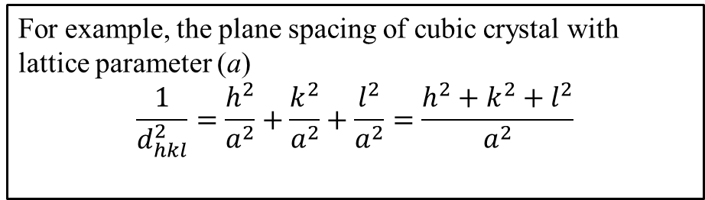
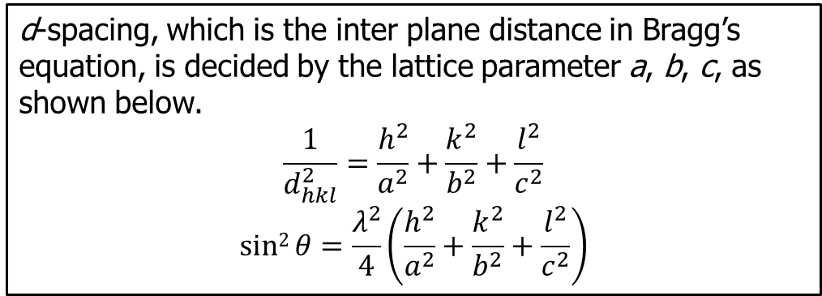
Relationship of d-spacing with lattice parameters and Miller indices
Bragg’s law relates the diffraction angle, 2θ, to d_{hkl}
In most diffractometers, the X-ray wavelength λ is fixed.
Consequently, a family of planes produces a diffraction peak only at a specific angle 2θ.
d_{hkl} is a geometric function of the size and shape of the unit cell
d_{hkl} is the vector drawn from the origin to the plane (hkl) at a 90° angle
d_{hkl}, the vector magnitude, is the distance between parallel planes of atoms in the family (hkl)
The position of diffraction peak is used to determine interplanar distance
The Miller indices (hkl) represent a series of parallel planes in a crystal with spacing of d_{hkl}.
For example, the plane spacing of cubic crystal with lattice parameter (a)
$$\frac{1}{d_{hkl}^{2}}=\frac{h^{2}}{a^{2}}+\frac{k^{2}}{a^{2}}+\frac{l^{2}}{a^{2}}=\frac{h^{2}+k^{2}+l^{2}}{a^{2}}$$
d-spacing, which is the inter plane distance in Bragg’s equation, is decided by the lattice parameter a, b, c, as shown below.
$$\frac{1}{d_{hkl}^{2}}=\frac{h^{2}}{a^{2}}+\frac{k^{2}}{b^{2}}+\frac{l^{2}}{c^{2}}$$
$$sin2{θ}=\frac{λ^{2}}{4}\left(\frac{h^{2}}{a^{2}}+\frac{k^{2}}{b^{2}}+\frac{l^{2}}{c^{2}}\right)$$

Slide 13
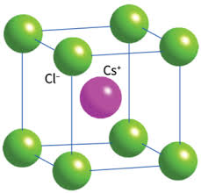
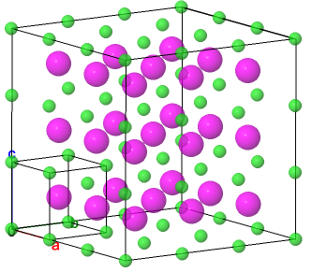
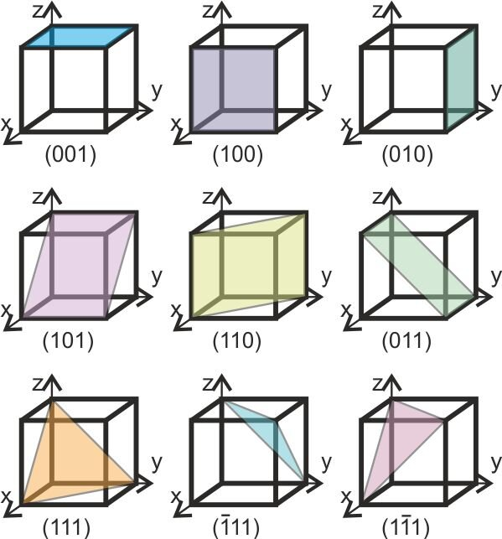
Basics of Crystallography
A crystal consists of a periodic arrangement of the unit cell into a lattice.
The unit cell can contain a single atom or atoms in a fixed arrangement.
c
b
a
Unit cell
Crystal
Crystal Planes
Crystals consist of planes of atoms that are spaced a distance d apart, but can be resolved into many atomic planes, each with a different d spacing.
a, b and c (length) and α, β and γ angles between a, b and c are lattice constants or parameters which can be determined by XRD.

Slide 14
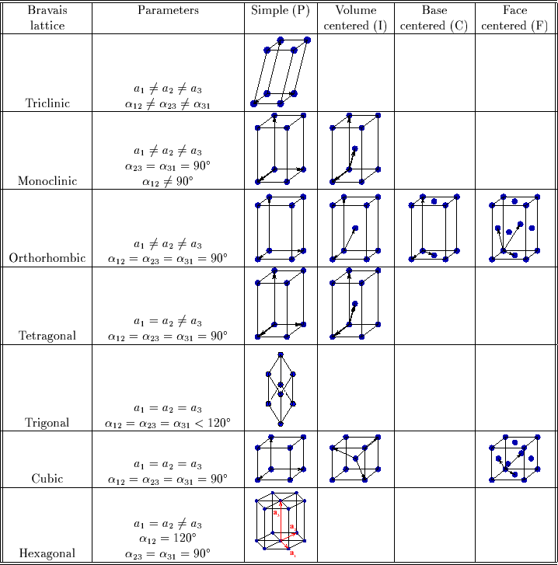
Seven Crystal Systems - Review
Miller Indices (hkl)
Miller indices-the reciprocals of the fractional intercepts which the plane makes with crystallographic axes
 | a (Å) | b (Å) | c(Å) | a (Å) | b (Å) | c(Å)
Axial length (lattice parameter) | 4 | 8 | 3 | 4 | 8 | 3
Intercept length | 1 | 4 | 3 | ∞ | 8 | ∞
Fractional Intercepts | 1/4 | 1/2 | 1 | ∞ | 1 | ∞
Miller Indices | 4 | 2 | 1 | 0 | 1 | 0
(010)

Slide 15
Quartz
Pyrite
Rocksalt
Cubic
Cubic
Trigonal
Examples of some Crystals (periodic structures)
Rhombohedral

Slide 16
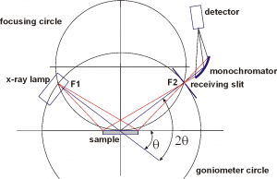
Powder X-ray Diffractometer
Most of powder diffractometers use Bragg-Brentano parafocusing geometry, offering high-resolution and high beam-intensity analysis at the cost of very precise alignment requirements and carefully prepared samples.
Bragg-Brentano (BB) Geometry
Goniometer
Detector
X-ray tube
Monochr.
Soller slits
Receiving slit
Divergence slit
Anti-scatter slit
Mask
Sample stage

Slide 17
Comparison Bragg-Brentano Geometry versus Parallel Beam Geometry
The Bragg-Brentano Geometry
Parallel-Beam Geometry with Göbel Mirror

Slide 18
Grazing Incidence X-ray Diffraction (GIXRD) (Thin films)

Slide 19
Divergence Slits
Programmable divergence slit
Fixed irradiated length
Fixed divergence slit

Slide 20
Diffraction methods
Laue method
Rotating crystal method
Powder method
nλ = 2d sinθ
Method | λ | θ | Sample
Laue | Variable | Fixed | Single crystal
Rotating Crystal | Fixed | Variable (in parts) | Single crystal
Powder Diffraction | Fixed | Variable | Powder /polycrystalline

Slide 21
Laue method
Was developed first (1912 by Max Theodor Felix von Laue himself, [Nobel prize 1914]. Inspiration came from dr. Student Paul Ewald at LMU Münich.1))
Beam of white radiation used.
Sample is fixed (usually a single crystal).
Transmission / back reflection Laue methods.
Diffracted beams form spots on the film which lie on elliptical/hyperbola curves, originating from planes belonging to same zone (=pattern).
Is used mainly for determination of the crystal orientation or the assessment of the crystal quality.
nλ = 2d sinθ
source/more information P.P. Ewald, 50Years of XRD, IUCR, 1962: http://www.iucr.org/publ/50yearsofxraydiffraction

Slide 22
Laue method, cont.
• Back-reflection laue
• Transmission laue

Slide 23
Rotating crystal method
A monochromatic beam and a single crystal sample used.
Sample is mounted with one of its axes (or other important direction) normal to the beam and rotated about the chosen direction.
The diffracted beams are on imaginary cones which have cone axis coinciding with the rotation axis.
Film is positioned cylindrically around the sample and the axis of rotation.
Method is used in the determination of unknown crystal structures, i.e., polymers.

Slide 24
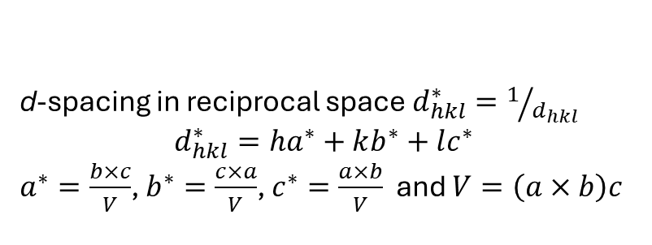
Origin of powder diffraction
d-spacing in reciprocal space $d_{hkl}^{∗}=1/{d_{hkl}}$
$$d_{hkl}^{∗}=ha^{∗}+kb^{∗}+lc^{∗}$$
$a^{∗}=\frac{b×c}{V}$, $b^{∗}=\frac{c×a}{V}$, $c^{∗}=\frac{a×b}{V}$ and $V=\left(a×b\right)c$

Slide 25
X-ray Powder diffraction Pattern

Slide 26
Powder diffraction
A polycrystalline sample should contain thousands of crystallites.
Therefore, all possible diffraction peaks should be observed.
For every set of planes, there will be a small percentage of crystallites that are properly oriented to diffract (the plane perpendicular bisects the incident and diffracted beams).
Basic assumptions of powder diffraction are that for every set of planes there is an equal number of crystallites that will diffract and that there is a statistically relevant number of crystallites, not just one or two.

Slide 27
Single crystal diffraction
A single crystal specimen in a Bragg-Brentano diffractometer would
produce only one family of peaks in the diffraction pattern.
At 20.6 °2θ, Bragg’s law fulfilled for the (100) planes, producing a diffraction peak.
The (110) planes would diffract at 29.3 °2θ; however, they are not properly aligned to produce a diffraction peak (the perpendicular to those planes does not bisect the incident and diffracted beams). Only background is observed.
The (200) planes are parallel to the (100) planes. Therefore, they also diffract for this crystal. Since d200 is ½ d100, they appear at
42 °2θ.

Slide 28
Understanding powder diffraction pattern

Slide 29
Quality of intensity measurements!
The measured intensity is directly proportional to the number of counts and therefore, the accuracy of intensity measurement is governed by statistics.
Collect at least 10000 counts for
strongest peak!
where σ is standard deviation, ε is error at certain confidence level, Q = 0.67, 1.64, 2.59 and 3.09 for 50, 99, 99.9% confidence levels, respectively

Slide 30
Preferred Orientation
Extreme problem for samples with crystal related shape
or non-spherical particles

Slide 31
Preferred Orientation

Slide 32
Crystal Size
Suppose the crystal of thickness t has (m + 1) planes in the diffraction direction.
θ is variable with value θB that exactly satisfies Bragg’s Law:
nλ = 2d sinθ
Rays A, D, …, M makes angle θB; path difference is λ, so A’, D’ …M’ are all in phase.
Rays B, L makes angle θ1; if path different of B’, L’ is (m+1)λ, in the midway there is a plane is out of phase with B’, therefore at θ1 intensity is 0.
Rays C, N makes angle θ2; if path different of C’, N’ is (m-1)λ, in the midway there is a plane is out of phase with C’, therefore at θ1 intensity is 0.

Slide 33
Crystal Size
For angle θB diffracted intensity is maximum
For θ1 and θ2 – intensity is 0.
For angles θ1 > θ > θ2 – intensity is nonzero.

Slide 35
To measure the instrumental broadening is a simple matter of carrying out a high-quality scan on a certified standard reference material. LaB₆ and Si are common choices. A note of caution though, instrumental broadening changes with X-ray optics. You therefore need to measure the reference material and your samples using the exact same optic and detector settings to be sure that the instrumental broadening that your measured on the reference material matches exactly the broadening from your experimental measurement.
The source of radiation (X-rays or neutrons) has a finite physical size (i.e. is not a perfectly sharp spot or line)
The radiation is not perfectly monochromatic, but rather consists of a small range, δλ, of wavelengths around the mean, λ
The active diffracting volume within the sample is finite and therefore diffraction occurs away from the true center of the diffractometer - this factor can be compounded by a low sample absorption to the radiation
Axial divergence of the incident/diffracted beams
The configuration of defining slits used in the diffractometer
Any misalignment of the diffractometer

Slide 36
Crystal size measurement - Application
Scherrer Equation
B = FWHM (in radians); t = diameter of the
crystallites; λ is wavelength of anode material;
θ: Bragg angle (in radians); K is shape factor.
Condition: when strain caused broadening is zero.
B is essentially zero when the crystallite size exceeds about 1000Å, (or >1μm to be in safe side).

Slide 37
The Effect of Strain
The uniform strain, macrostrain cause the peak shift, which is the basic for stress measurement. While the nonuninform strain, microstrain cause the peak broadening and also increase the integrated intensity.
B = 2ε tanθ
ε
macrostrain

Slide 38
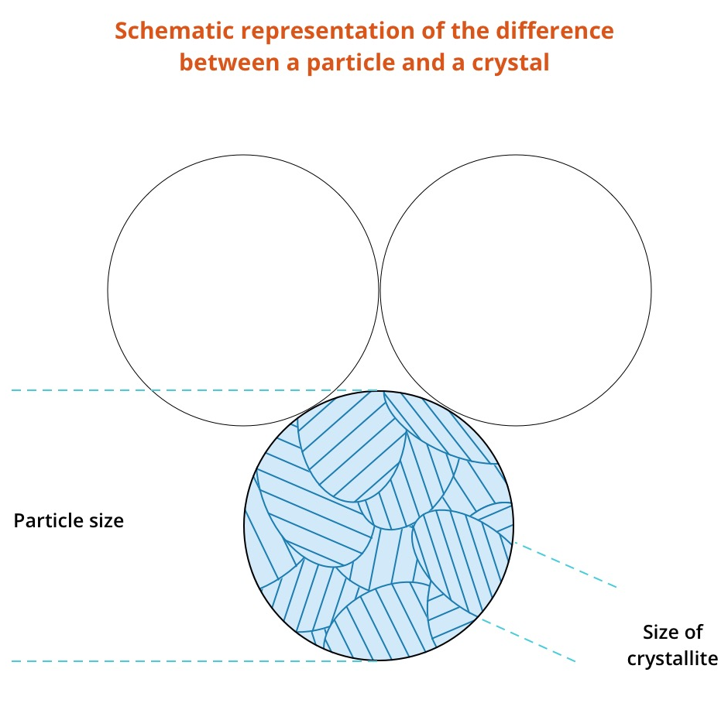
Peak Broadening
This is a y = b + mx function. Plot sin θ - Bsize+strain cosθ, the crystal size and strain can be found from the curve.
http://pd.chem.ucl.ac.uk/pdnn/peaks/sizedet.htm
Crystal size is a measure of a coherently diffracting domain; therefore a particle may be different to a crystal (see right). Many powders are agglomerates of smaller crystals, and in XRD we measure the individual crystals.
Crystal (grain) size broadening

Slide 39
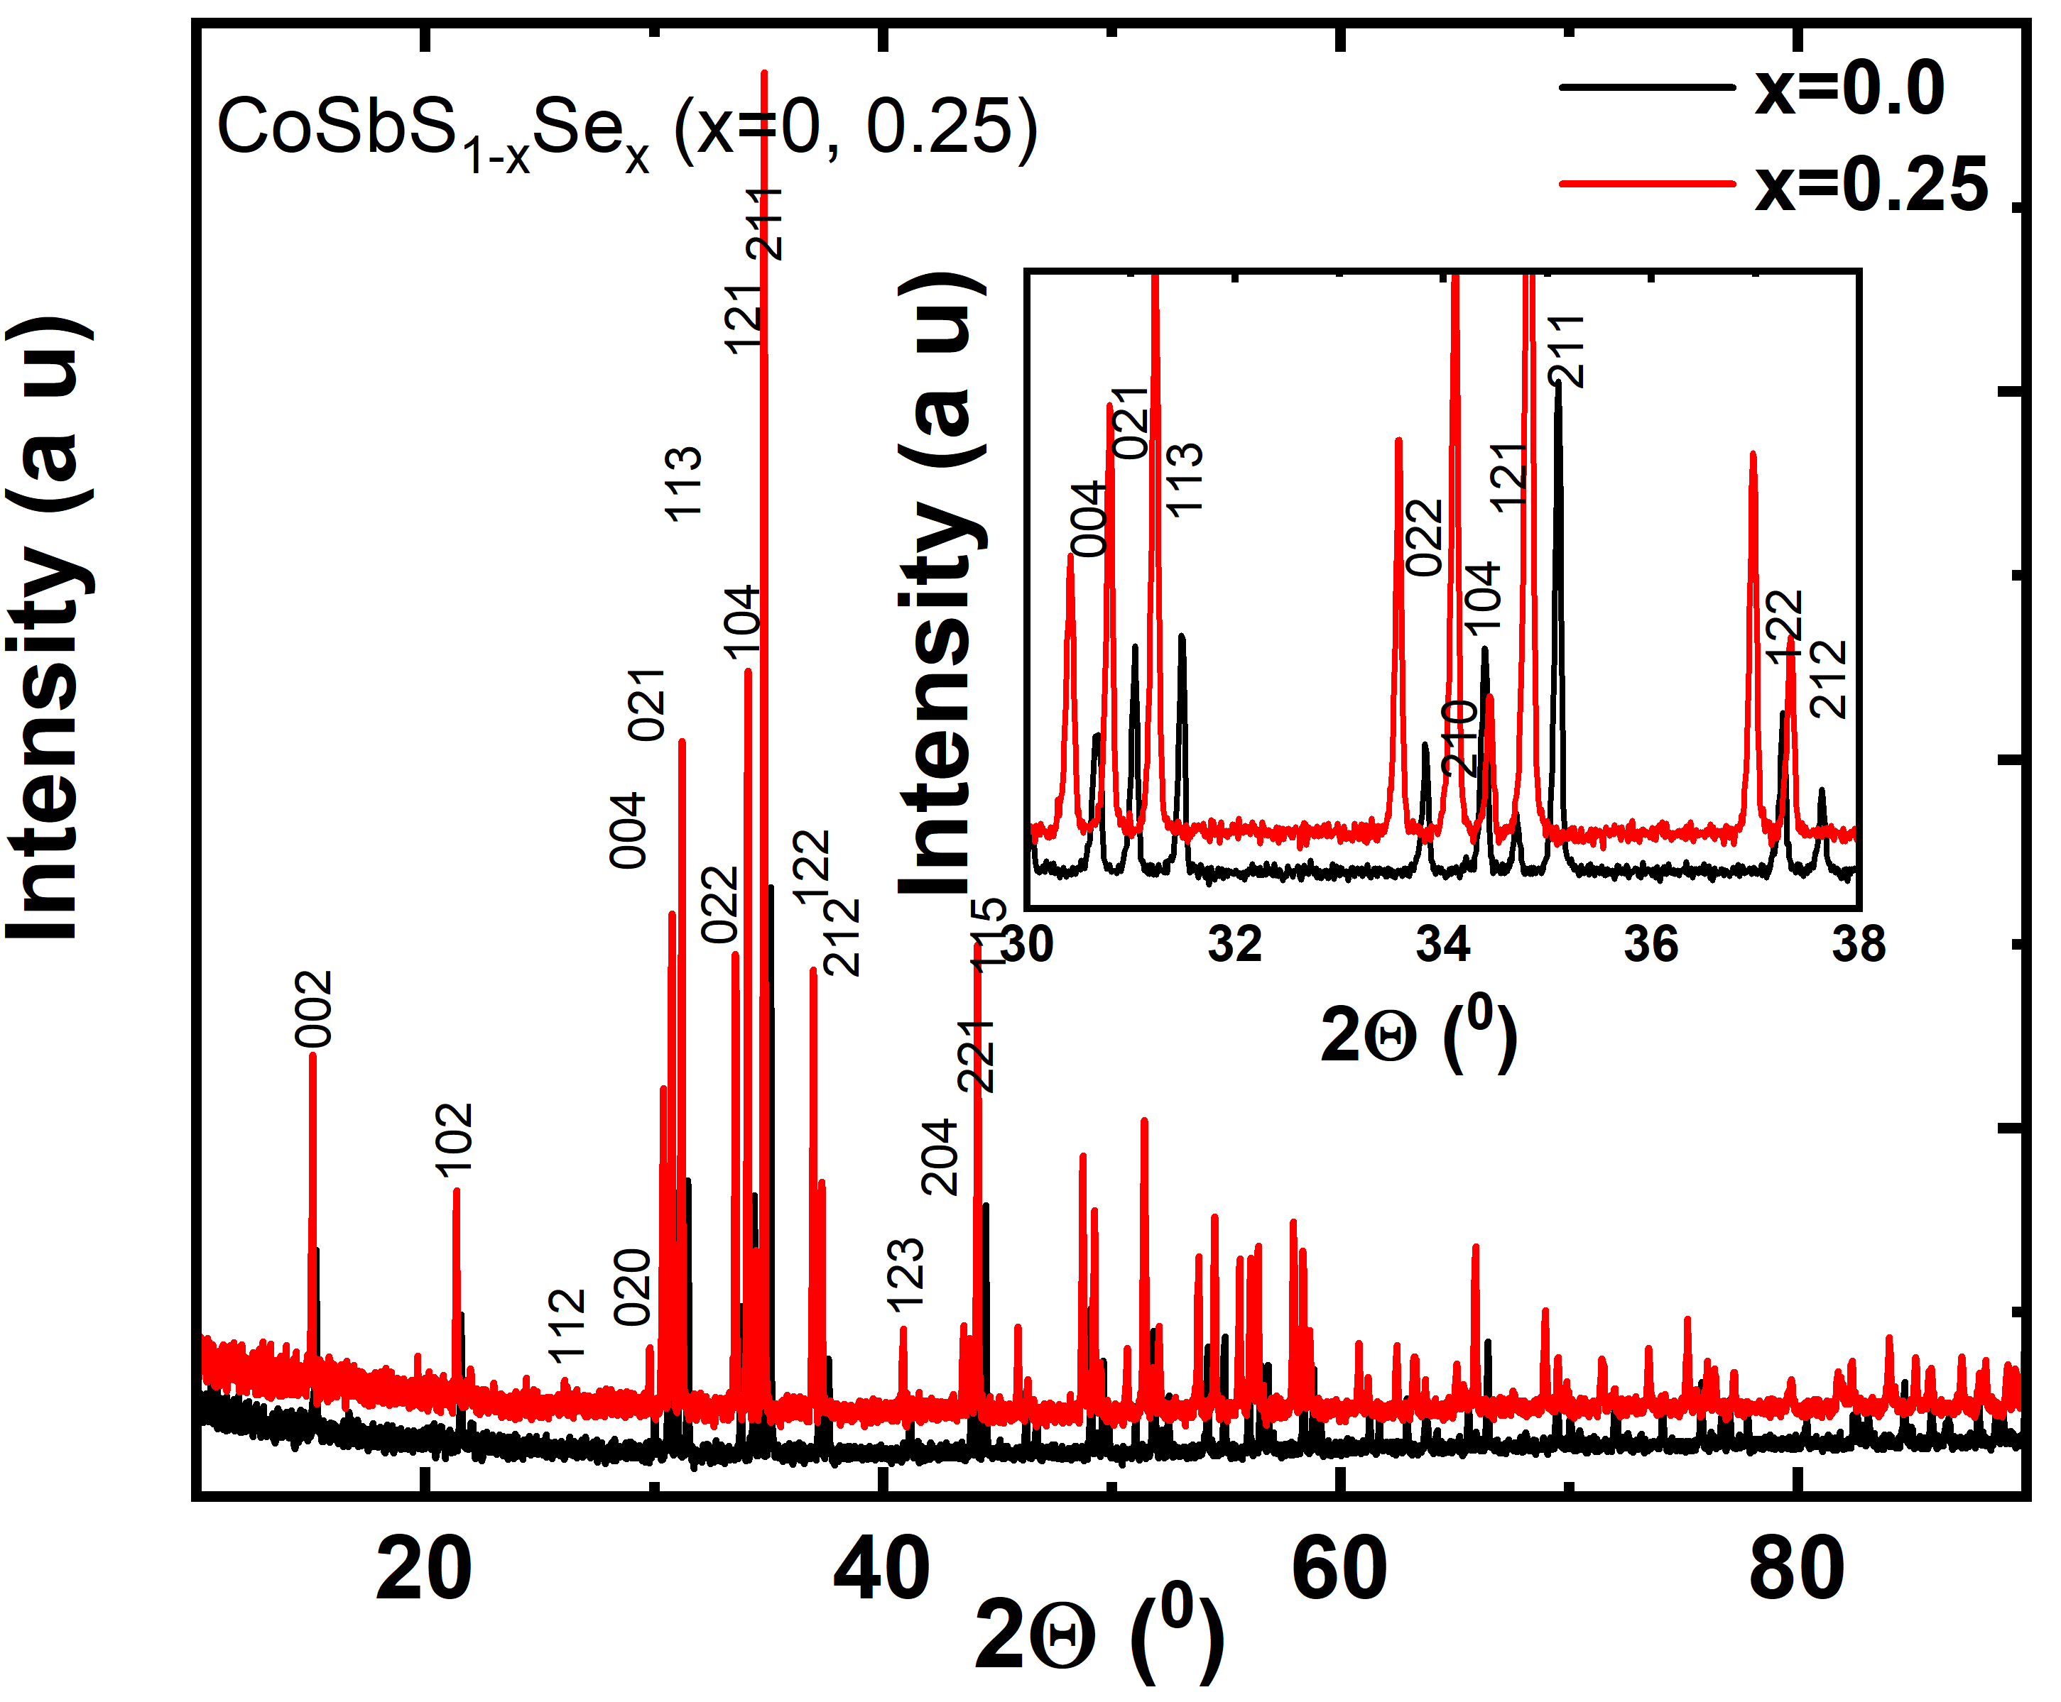
Data Analysis:
What kind of things can be observed through XRD measurements

Slide 40
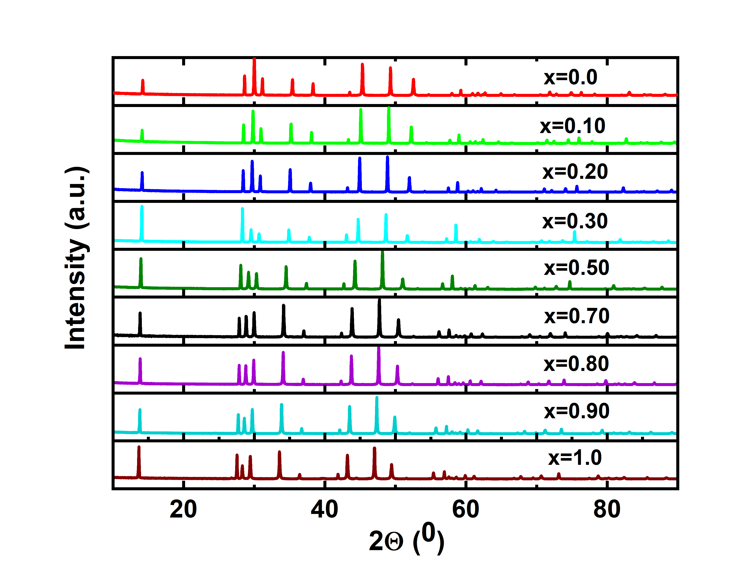
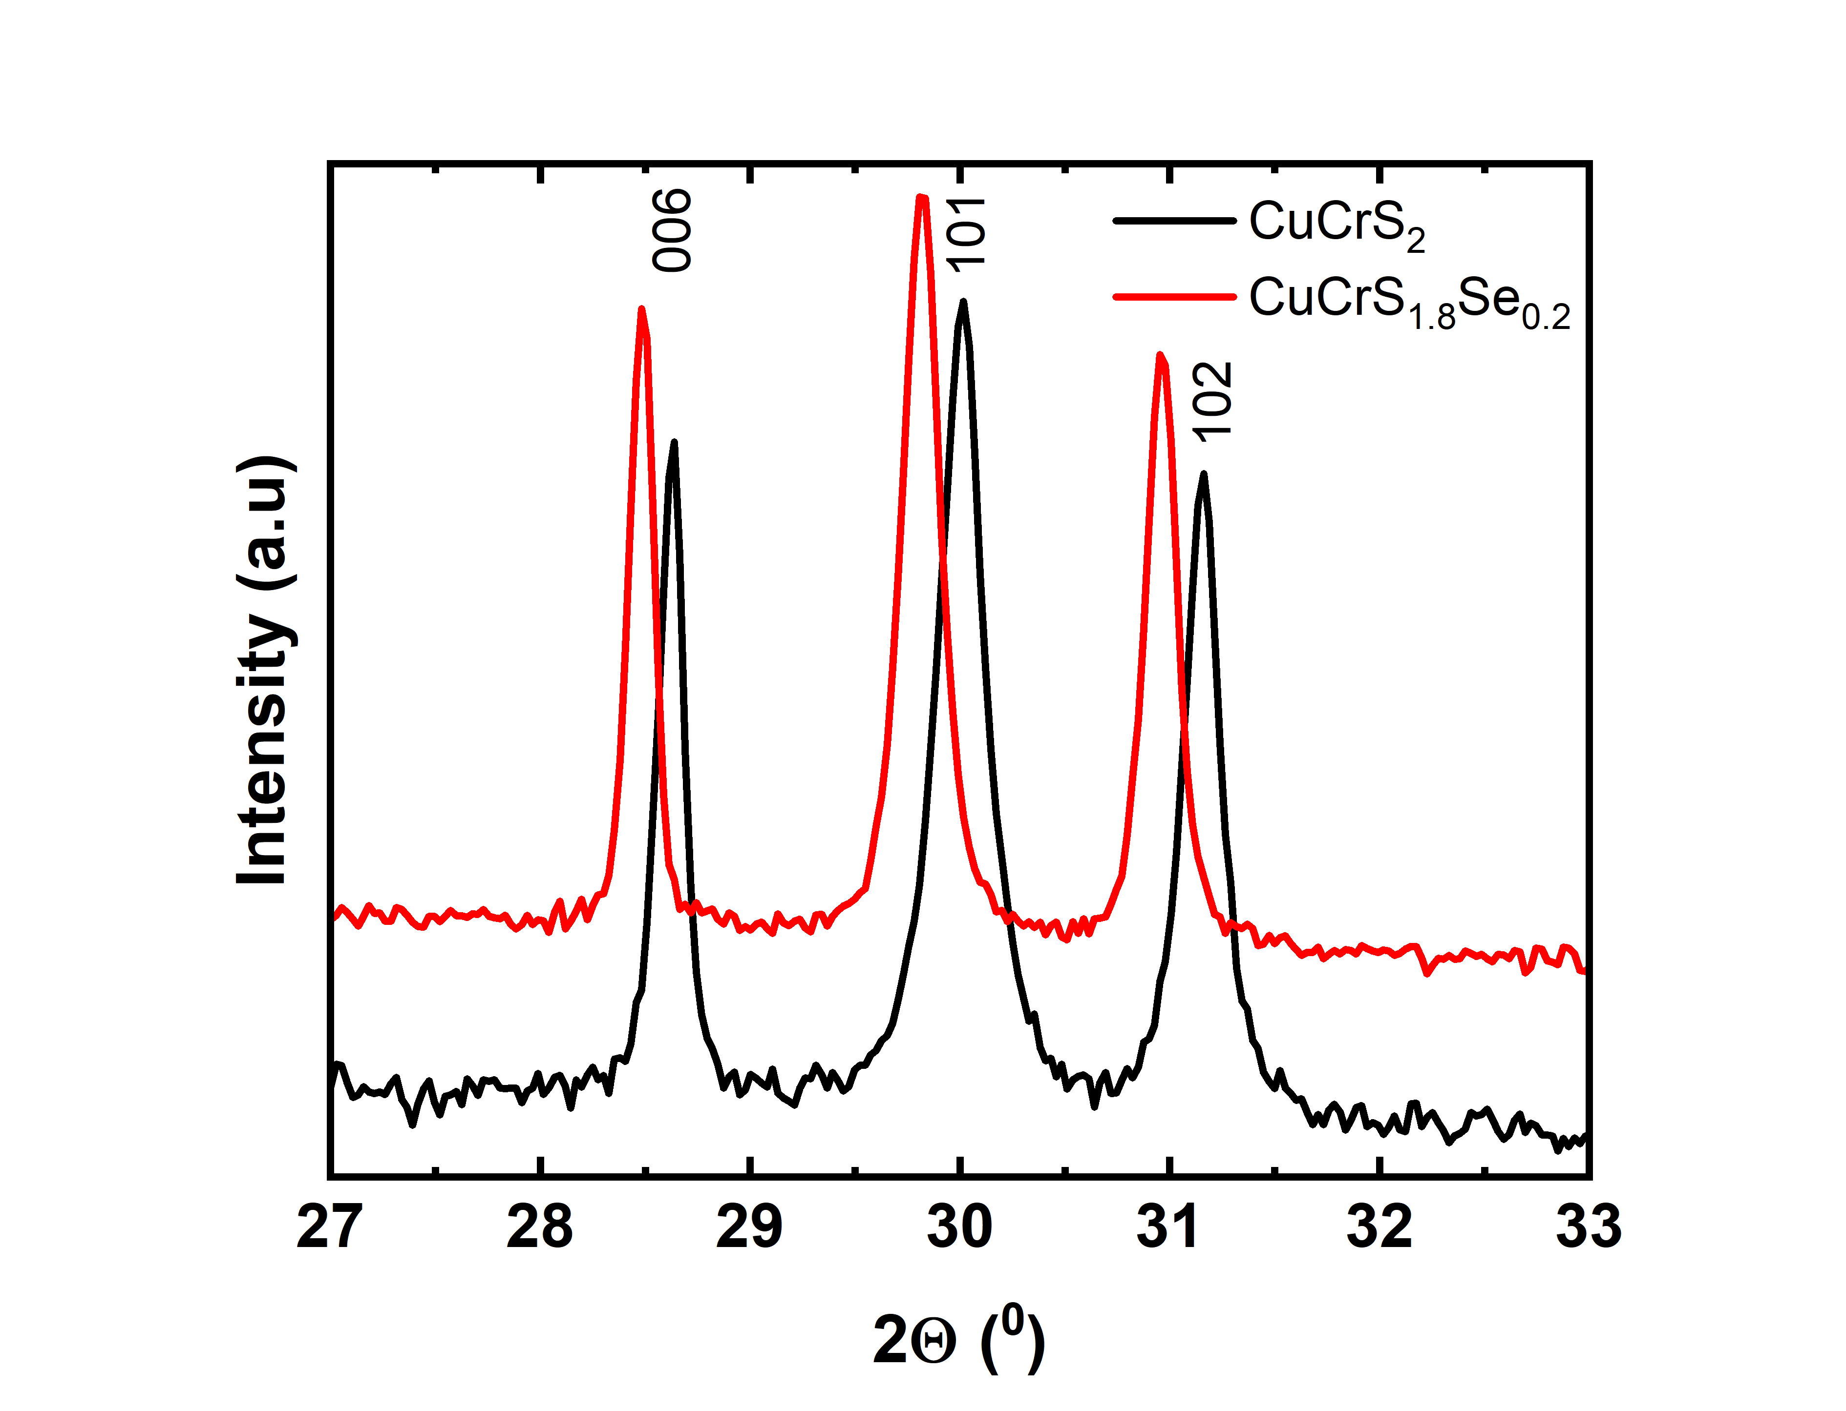
CuCr(S_{1-x}Se_{x})₂ (x=0, 1.0)

Slide 41
Books and Internet sources
Elements of X-ray Diffraction, Second Edition, by B.D. Cullity.
Elements of X-ray Diffraction, Third Edition, by B. D. Cullity & S. R. Stock
Fundamentals of Powder Diffraction and Stucturual Characterization of Materials, Second Edition, by Vitalij K. Pecharsky & Peter Y. Zavalij
Materials Characterization, introduction to Microscopic and Secptroscopic Methods, second edition, by Yang Leng
X-Ray Diffraction: A Practical Approach. By Suryanarayana, C., Norton, M. Grant
http://epswww.unm.edu/labs/x-ray-diffraction-lab/intro-course-info/
http://web.stanford.edu/group/glam/xlab/MatSci162_172/LectureNotes. Html
http://www.ruppweb.org/Xray/tutorial/ewald.htm
http://pd.chem.ucl.ac.uk/pdnn/peaks/sizedet.htm
PANAlytical basic course

